Slide 1
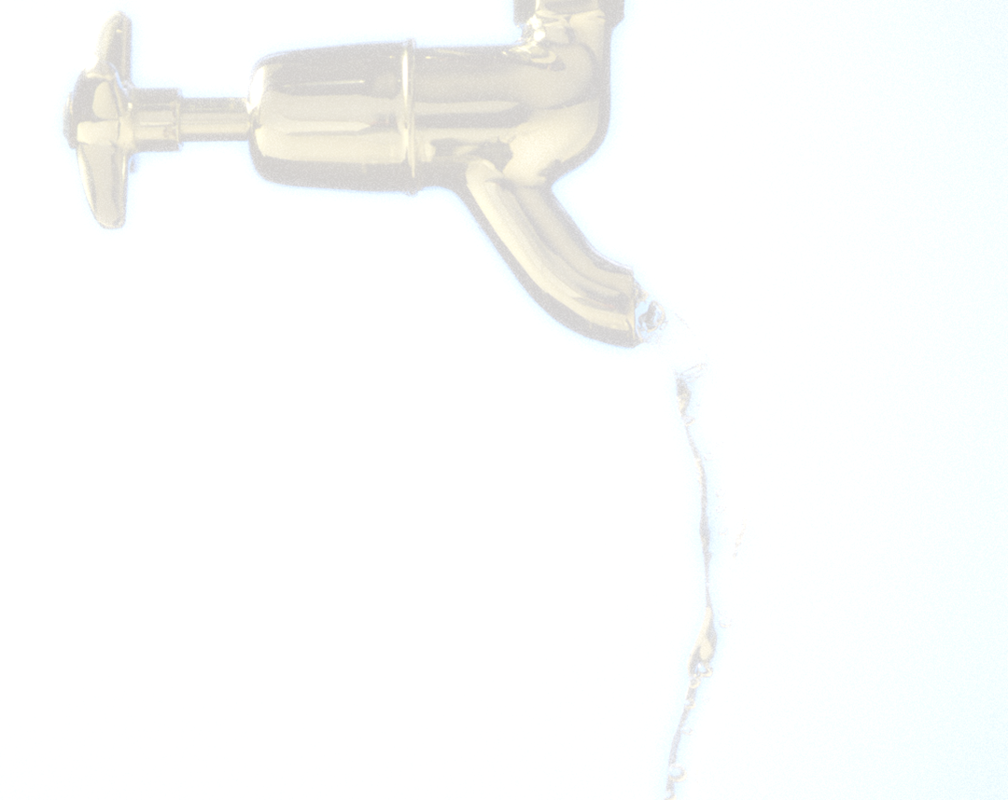
Tuesday, June 20, 2017
Registration: 11:30 AM‐Noon
Luncheon and Discussion:
Noon‐1:00 PM
Second Harvest Food Bank
411 Mercy Drive
Orlando, Florida 32805
CENTRAL FLORIDA CHAPTER
FWEA
Technical Luncheon
Discussion Topic:
Who Needs Pretreatment? Not OCU Operational Aquifer
Storage and Recovery
Presenter:
Kim Kunihiro, P.E., Orange County Utilities
Mary Fickert Thomas, P.E., WSP USA
Please RSVP by Friday, June 16th, 2017.
Please mail check to Megan Nelson, P.E., at Orange County Utilities.
9150 Curry Ford Road, Orlando, FL 32825
One PDH credit will be given for attending.
Make checks payable to “FWEA” for $25.00.
Registrations after June 16th will be charged $30.00
No shows will be invoiced.
Students admission is $10.00.
Please register on-line for the event.
RSVP to: Jennifer Roque Email: jennifer.roque@tetratech.com
Please also contact Jennifer if you’re interested in sponsoring this event!

